Slide 1


TE ECS
BREAKING THE SILENCE
EMPOWERING VICTIMS & RAISING AWARENESS ON SEXUAL VIOLENCE
10th October, 2024

Slide 2

TABLE OF CONTENT
BREAKING THE SILENCE
01
04
Introduction
Physchology & Impacts
02
05
Laws, Prevention & Social Awareness
Topic of Discussion
03
06
Case Studies
Conclusion

Slide 3
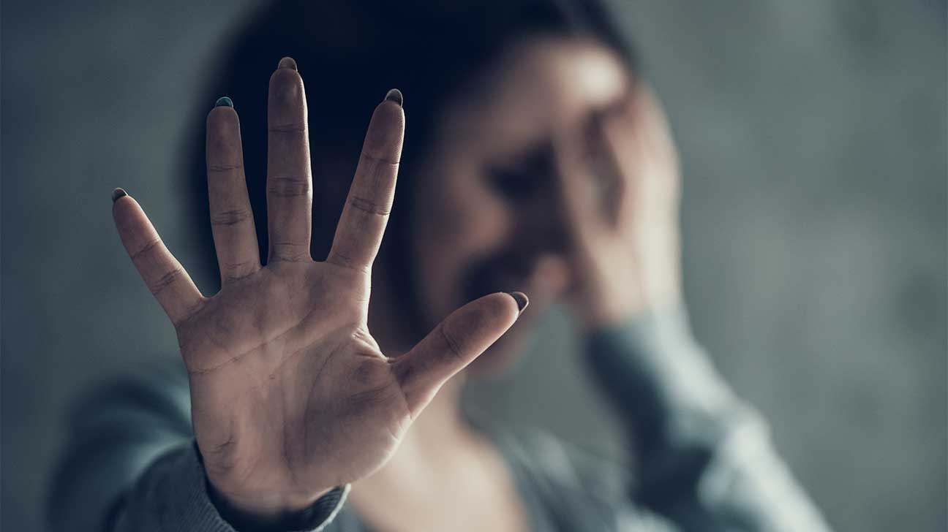
INTRODUCTION
ABOUT THE TOPIC
Pervasive Issue: Rape, sexual abuse, and sexual assault occur globally across all social, cultural, and geographical boundaries.
Physical and Psychological Trauma: Victims face deep trauma, while society often perpetuates fear, shame, and stigma.
Underreporting: Millions of cases go unreported each year due to fear, stigma, and distrust in the justice system.
WHO Statistics: 1 in 3 women globally (around 736 million) experience sexual or physical violence, mostly by intimate partners.
UNODC Data: An estimated 250,000 rape cases reported globally annually, but this likely represents only a small fraction of the true total.

Slide 4
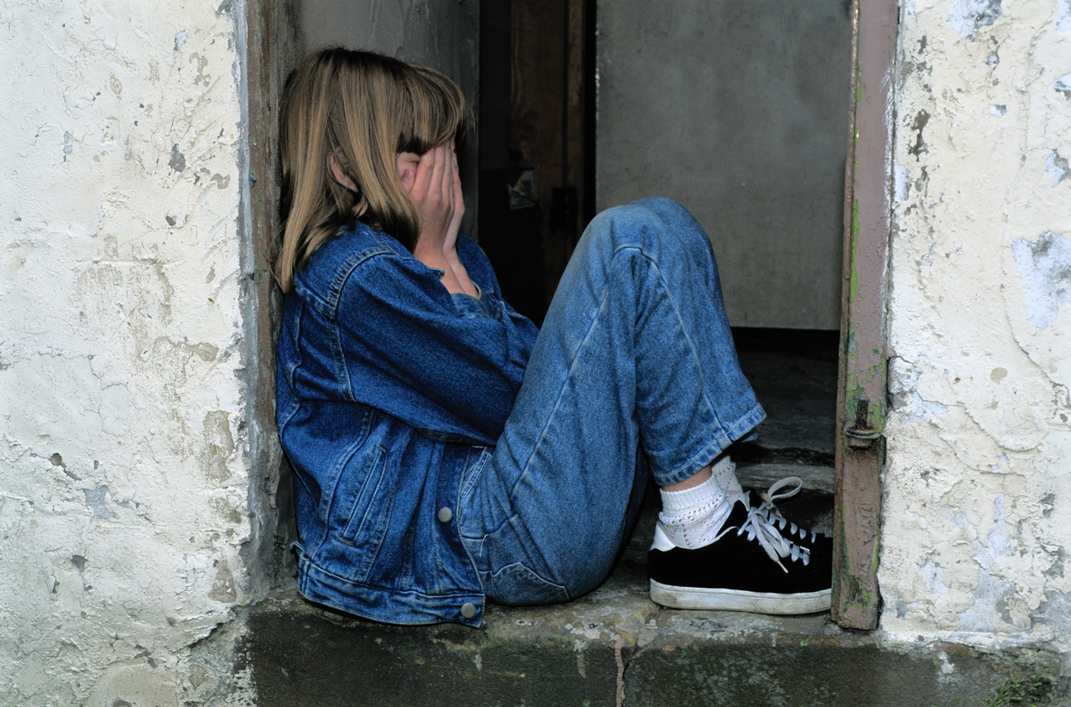
INTRODUCTION
ABOUT THE TOPIC
High Incidence: Over 31,000 rape cases were reported in 2021, an average of 85 rapes per day.
Underreporting: Cultural stigma, victim-blaming, and fear of retaliation prevent many victims from reporting.
Child Sexual Abuse: A significant portion of rape cases in India involve minors.
Systemic Issues: Patriarchal norms and flaws in law enforcement contribute to the normalization of sexual violence.
Legal Reforms: Despite the 2013 Criminal Law (Amendment) Act introducing stricter punishments, much progress is still needed for swift justice and survivor safety.

Slide 5

TOPIC OF DISCUSSION
WHAT IS SEXUAL ASSAULT ?
Definition: Sexual assault refers to any non-consensual sexual act or behavior. This can include a range of actions, such as
Rape
Attempted Rape
Unwanted Touching
Sexual Coercion
Fondling
HOW DOES IT TAKE PLACE ?
Lack of Consent: The central element of sexual assault is the absence of consent. Consent must be clear, coherent, willing, and ongoing. Factors such as intoxication, coercion, or threats undermine the ability to give consent.
Acquaintance Assault: Many sexual assaults occur between individuals who know each other, often in social settings (parties, dates).
Stranger Assault: Less common but still significant; this involves attacks by individuals unknown to the victim.
Power Dynamics: Perpetrators may exploit positions of power or authority, such as in relationships, workplaces, or institutions.
Intimidation or Threats: Using threats of violence or other consequences to force compliance.
Substance Use: Perpetrators may use drugs or alcohol to incapacitate the victim, making it impossible for them to consent.
Victim-blaming: Survivors often face stigma and blame, discouraging reporting and perpetuating a culture of silence.

Slide 6
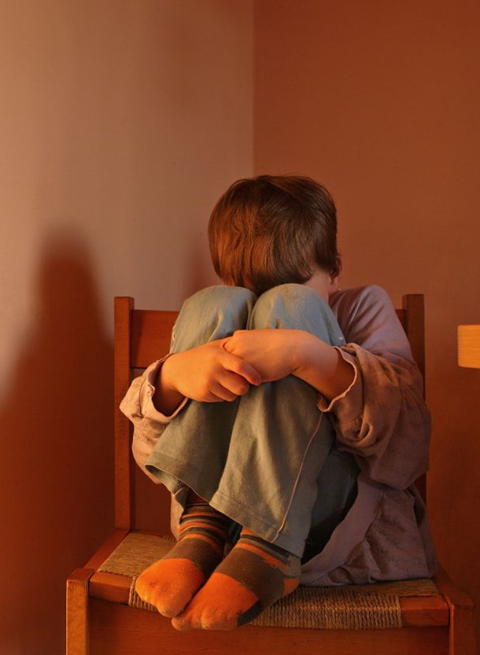
TOPIC OF DISCUSSION
HOW DOES CHILD ABBUSE TAKE PLACE ?
Lack of Awareness: Some caregivers may not recognize their behavior as abusive, particularly in cases of emotional or psychological abuse.
Family Dynamics: Abuse often occurs within the home, sometimes as a result of parental stress, substance abuse, or mental health issues.
Community Influences: Environments that tolerate violence or have weak support systems can contribute to higher rates of abuse.
METHODS
Physical Acts: Includes hitting, shaking, or other forms of physical violence.
Verbal Abuse: Using harsh words, threats, or shaming to control or manipulate a child.

Slide 7
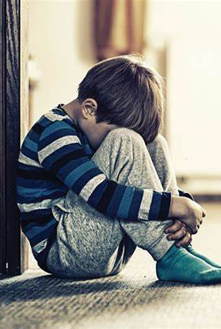
TOPIC OF DISCUSSION
HOW DOES CHILD ABBUSE TAKE PLACE ?
Sexual Exploitation: Adults may groom children for sexual abuse by building trust and then exploiting that trust.
Neglectful Behavior: Failing to provide adequate supervision, nutrition, or medical care.
Power Dynamics: Abusers often hold positions of power or authority over the child, making it difficult for the child to speak out or escape the situation. This could be a parent, guardian, teacher, or coach.
Cultural and Societal Influences:
Normalization of Violence: Societal attitudes that accept or downplay abusive behavior can perpetuate abuse.
Stigma and Fear: Fear of repercussions or disbelief can prevent children from reporting abuse.
Substance Abuse: Caregivers struggling with addiction may be more likely to neglect or abuse their children due to impaired judgment or inability to meet basic needs.

Slide 8
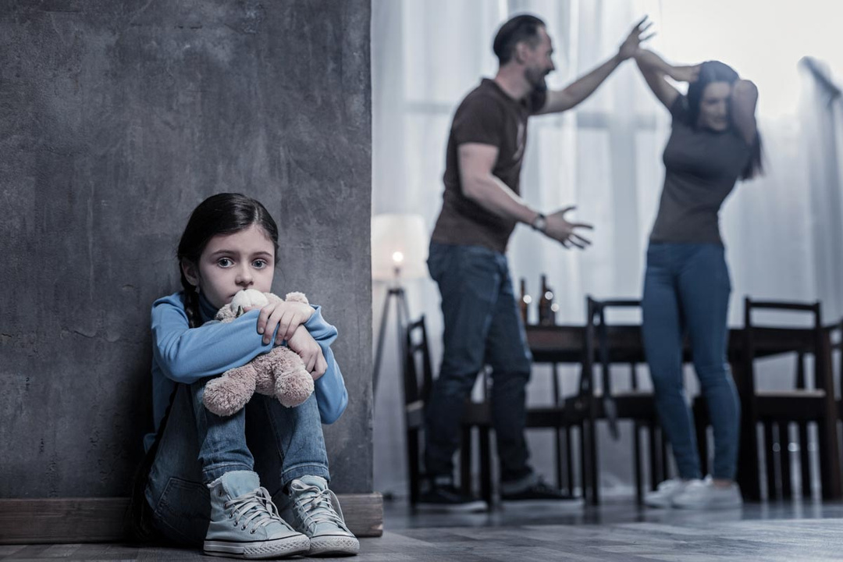
CONNECTION BETWEEN SEXUAL ASSAULT & CHILD ABBUSE
Vulnerability: Children are particularly vulnerable to sexual assault due to their developmental stage, dependency on adults, and often limited understanding of consent.
Cycle of Abuse: Research suggests that individuals who experience abuse as children may be at greater risk of being victimized or perpetrating abuse later in life.
Legal and Social Responses: Both issues require robust legal frameworks and social services to protect victims, provide support, and hold perpetrators accountable.

Slide 9
CASE STUDY
Rape and Murder of a Trainee Doctor at RG Kar
Medical College (2024)
Overview
In August 2024, a trainee doctor was raped and murdered at RG Kar Medical College and Hospital in Kolkata. This heinous crime ignited protests across India, drawing attention to both gender-based violence and the safety of healthcare workers. The case involved a 31-year-old female doctor who was attacked while on duty during a night shift. The Central Bureau of Investigation (CBI) took over the investigation, leading to several arrests, including a civic volunteer, a former college principal, and a police officer.
Time Line & Incidents
August 8, 2024: The Crime
The victim, a resident doctor at RG Kar Medical College, was resting in a seminar room during her night shift. A civic volunteer
from Kolkata Police, after consuming alcohol with a friend, returned to the hospital and found her asleep. He raped and
murdered her in the room, leaving her body behind.

Slide 10
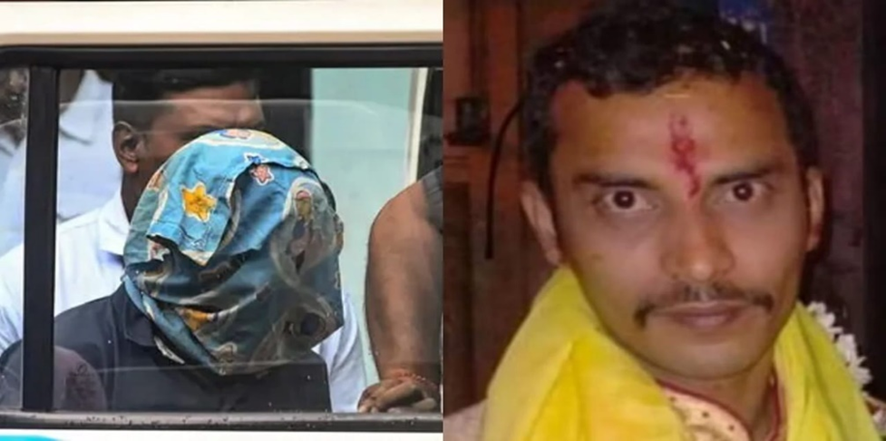
CASE STUDY
Rape and Murder of a Trainee Doctor at RG Kar
Medical College (2024)
August 9, 2024: Discovery of the Body
The doctor's body was found the next day with multiple injuries and signs
of sexual assault. Her body was discovered in the hospital's seminar hall.
The police began an investigation after registering the case, initially
focusing on hospital staff and individuals present at the hospital night.
August 10, 2024: Arrest of the Suspect
A civic volunteer with the Kolkata Police was arrested after CCTV footage
and DNA evidence linked him to the crime. He was charged with rape and
murder under sections of Indian law. His identity was later confirmed
through forensic evidence, and he was taken into custody.

Slide 11
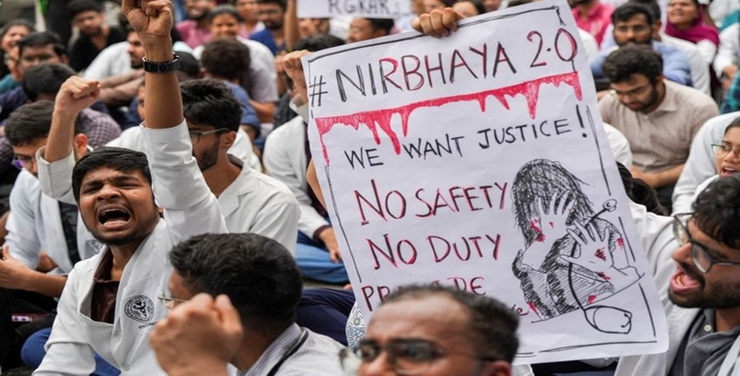
CASE STUDY
Rape and Murder of a Trainee Doctor at RG Kar
Medical College (2024)
August 13, 2024: Mass Protests Begin
The discovery of the crime led to widespread protests in Kolkata and across India. The medical community, including junior
doctors and medical staff, went on strike demanding justice, improved safety measures, and security in hospitals. Protests
spread across major cities, with junior doctors in Kolkata going on
strike for more than 40 days.
August 13, 2024: CBI Takes Over
Amid mounting pressure and criticism of the local police, the Calcutta
High Court handed the case over to the CBI Investigations by the CBI
expanded to include other individuals involved in covering up
evidence and delaying the registration of a First Information Report
(FIR)
August-September 2024: Additional Arrests
The former principal of RG Kar Medical College and a police officer were arrested for tampering with evidence and delaying
the investigation. Both individuals` accused of compromising the crime scene and failing to ensure timely police action.

Slide 12
CASE STUDY
Rape and Murder of a Trainee Doctor at RG Kar
Medical College (2024)
October 7, 2024: Formal Charges Filed
The CBI formally charged the accused civic volunteer with rape
and murder.
The evidence included DNA analysis and CCTV footage.
Protests continued as medical unions called for more protection
for healthcare professionals and faster resolution of the case.
Key Facts
Victim: A 31-year-old female trainee doctor at RG Kar Medical
College
Accused: A civic volunteer with the Kolkata Police.
Location: RG Kar Medical College and Hospital, Kolkata.
Crime: Rape and murder while the victim was resting during her
night shift.
Investigation: Led by the Central Bureau of Investigation after the
local police were accused of mishandling the case.
Evidence: CCTV footage and DNA samples matching the accused
were crucial in the investigation
Public and Medical Response
Protests: Doctors across India, especially in Kolkata, went on
strike demanding improved security for healthcare workers, an investigation into corruption in the healthcare sector, and justice
for the victim. More than 8,000 doctors in the state of West Bengal suspended non-emergency services, and some doctors initiated a hunger strike.
·Medical Community's Demands: The Federation of All India
Medical Associations (FAIMA) demanded stronger legal protections
for healthcare professionals and called for the case to be fast-tracked through the courts
Government Response: The West Bengal government promised to
meet some of the protesters demands, including replacing key police officers and health officials. They also temporarily suspended female doctors from night duty, although this measure was later criticized
by the Supreme Court and revoked.

Slide 13
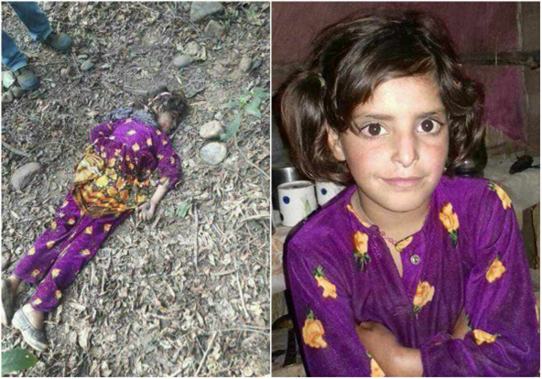
CASE STUDY
KATHUA RAPE CASE (2018)
Overview
The Kathua rape case refers to the abduction, gang rape, and brutal murder of an 8-year-old girl, Asifa Bano, from the nomadic Bakarwal community in January 2018 in the Rasana village near Kathua, Jammu, and Kashmir, India. The case shocked the nation due to the horrific nature of the crime and the communal tensions it exacerbated.

Slide 14
CASE STUDY
KATHUA RAPE CASE (2018)
TIME LINE OF EVENTS
Abduction and Crime
January 10, 2018: Asifa Bano, an 8-year-old girl, goes missing while she was grazing her family's horses.
January 17, 2018: Her dead body is found in the forest, sparking a wave of outrage.
Investigation
January 22, 2018: The Jammu and Kashmir Crime Branch takes
over the investigation.
April 9, 2018: A chargesheet is filed against 8 accused, including
4 police officers. Forensic evidence confirms the gang rape and
murder, showing traces of drugs in her body, multiple instances of rape, and death by strangulation and head trauma.
Details of the Crime
According to the police chargesheet, the crime was premeditated. The motive behind the abduction and killing of Asifa was to drive out the Bakarwal Muslim community from the Hindu-majority region. She was kidnapped, drugged with clonazepam, raped repeatedly for several days, and eventually murdered inside
a Hindu temple.
The forensic analysis indicated that Asifa was sedated and gang-raped before
being strangled to death and bludgeoned with a stone. Her body was found a
week later, further escalating public outrage.

Slide 15
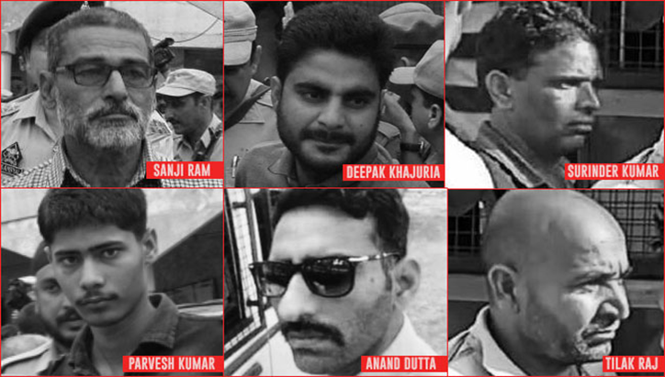
CASE STUDY
KATHUA RAPE CASE (2018)
Accused Individuals
The primary accused include:
Sanji Ram – The temple priest, considered the mastermind
behind the crime.
Deepak Khajuria – Special Police Officer.
Parvesh Kumar – Civilian.
Tilak Raj – Head Constable, involved in destroying evidence.
Arvind Dutta – Sub-Inspector, also involved in destroying
evidence.
Vishal Jangotra – Son of Sanji Ram.
Juvenile nephew of Sanji Ram – One of the key perpetrators
The charges against them include abduction, rape, and murder under various sections of the Ranbir Penal Code. Additionally, some police officers were
accused of attempting to destroy evidence and accepting bribes to cover up the crime.
.

Slide 16
CASE STUDY
KATHUA RAPE CASE (2018)
Forensic Evidence
A detailed forensic report showed that:
Clonazepam was found in the victim's system, indicating she was sedated.
The DNA evidence linked the accused to the crime.
Hair strands found at the crime scene matched Asifa's and the accused,
and vaginal swabs confirmed the presence of DNA from multiple accused.
Reactions and Protests
The incident sparked mass protests and global outrage. The gruesome nature of the crime, coupled with the accused being shielded by local politicians, incited communal tensions. Prominent voices, including political leaders, celebrities, and international organizations, condemned the act and demanded swift justice.
Prime Minister Narendra Modi and UN Secretary-General António Guterres condemned the attack, calling for justice. Mehbooba Mufti, Chief Minister of Jammu and Kashmir, stated that her government would ensure swift justice.
The United Nations issued a statement hoping that the authorities would
bring the perpetrators to justice.
Political and Communal Protests
The Hindu Ekta Manch, a local group supported by the Bharatiya Janata
Party (BJP), organized protests defending the accused, arguing that the investigation was politically motivated. Some BJP ministers even
participated in these protests.
Right-wing Hindu groups staged protests demanding the release of the
accused. They also claimed that the investigation was biased due to
political pressure.
The protests reached a boiling point when local lawyers in Kathua
attempted to block the police from filing the chargesheet in court.
Legal Proceedings
Charges Filed
The accused were charged under Sections 302 (murder), 376 (rape),
120-B (criminal conspiracy), and 201 (causing disappearance of
evidence) of the Ranbir Penal Code.

Slide 17
CASE STUDY
KATHUA RAPE CASE (2018)
Key Takeaways
Victim: Asifa Bano, an 8-year-old from the Bakarwal community.
Perpetrators: Seven individuals, including Sanji Ram, police officers, and family members.
Crime: Abduction, gang rape, and murder.
Motive: Drive out the Bakarwal community from the region.
Legal Outcome: Conviction of six accused, with life imprisonment for three.
Communal and Political Impact: Escalated communal tensions in Jammu and Kashmir, with support for the accused from right-wing Hindu groups.
Media's Role and Fines
The Delhi High Court fined 12 media houses, including The Hindu, Republic TV, and NDTV, for disclosing the identity of the rape victim in violation of laws meant to protect the identity of rape survivors and victims under the Protection of Children from Sexual Offences Act and the Indian Penal Code. The fines were directed to the Jammu and Kashmir Victim Compensation Scheme.

Slide 18

CASE STUDY
The Delhi Gang Rape and Its Impact on Child Sexual Abuse Laws (2012)
Introduction
The 2012 Delhi gang rape, commonly referred to as the Nirbhaya case,
involved a brutal assault and gang rape that occurred on December 16,
2012, in Munirka, South Delhi. The victim, Jyoti Singh, a 22-year-old physiotherapy intern, was assaulted while traveling with her male friend, Avnindra Pratap Pandey, on a private bus.
The case ignited national outrage, leading to widespread protests and significant changes in Indian laws concerning sexual violence, including
the enactment of the Protection of Children from Sexual Offences (POCSO)
Act, 2012, and amendments to the Criminal Law (Amendment) Act, 2013.

Slide 19
CASE STUDY
The Delhi Gang Rape and Its Impact on Child Sexual Abuse Laws (2012)
The Incident
On the night of December 16, 2012, Jyoti Singh and her friend boarded a
private bus. Six men, including the driver, were on the bus. After an
altercation, Jyoti's friend was beaten unconscious, and Jyoti was dragged
to the rear of the bus. The men took turns raping her and assaulting her
with an iron rod, inflicting severe injuries to her abdomen, intestines, and genitals. The assault continued while the bus driver drove through the
streets of Delhi.
Medical reports indicated the extensive damage caused by the assault,
with evidence suggesting that a blunt object, likely the L-shaped iron rod,
was used during the rape. After the attack, Jyoti was thrown out of the bus
and left for dead, but she was discovered and rushed to the hospital.
Despite fighting for her life for two weeks, she succumbed to her injuries.

Slide 20
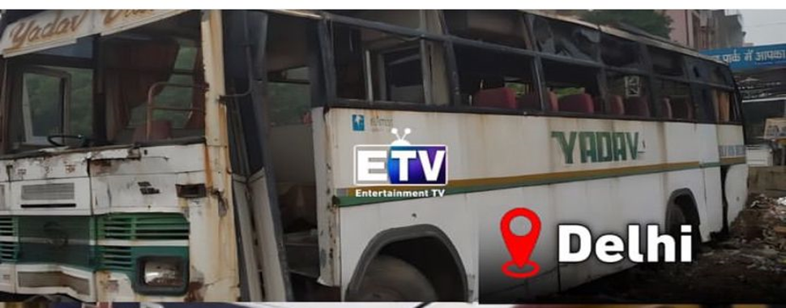
CASE STUDY
The Delhi Gang Rape and Its Impact on Child Sexual Abuse Laws (2012)
Investigation and Arrests
Following the incident, a Special Investigation Team (SIT), led by Pramod Kumar Kushwaha, Deputy Commissioner of Delhi Police's Special Cell, was formed to apprehend the culprits. The police quickly located the bus using CCTV footage and arrested the six men involved within 24 hours of the crime.

Slide 21
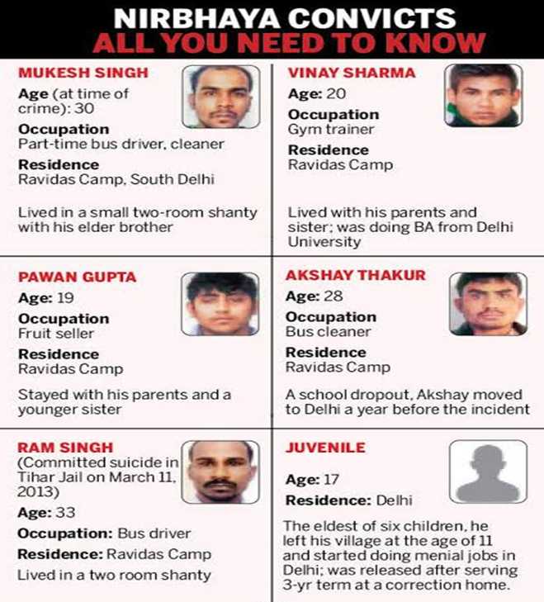
CASE STUDY
The Delhi Gang Rape and Its Impact on Child Sexual Abuse Laws (2012)
The accused were:
Ram Singh – the bus driver, aged 30.
Mukesh Singh – Ram Singh's 26-year-old brother.
Vinay Sharma – a 20-year-old assistant gym instructor.
Pawan Gupta – a 19-year-old fruit seller.
Akshay Thakur – a 28-year-old laborer from Bihar.
A 17-year-old juvenile – who had joined the group on the day of the incident.
Ram Singh later died in police custody under suspicious circumstances,
with authorities claiming suicide, while his family alleged foul play.

Slide 22
CASE STUDY
The Delhi Gang Rape and Its Impact on Child Sexual Abuse Laws (2012)
Trial and Sentencing
The five adult accused were tried in a fast-track court. On September 10, 2013, Pawan Gupta, Vinay Sharma, Akshay Thakur, and Mukesh Singh were found guilty of rape and murder. Three days later, they were sentenced to death. The Delhi High Court upheld the death sentence on March 13, 2014.
The juvenile accused, due to his age, was tried separately under juvenile laws and received the maximum sentence of three years in a reform home.
Legal and Societal Impact
The Protection of Children from Sexual Offences (POCSO) Act, 2012
While the Nirbhaya case did not directly involve child sexual abuse, it underscored the gaps in India's legal system concerning sexual offenses. This led to the implementation of the POCSO Act, aimed at protecting minors from sexual violence. Key provisions included:
Gender-neutral definitions of child sexual abuse.
Mandatory reporting of sexual offenses involving children.
The creation of special courts to handle cases involving minors and expedite
trials.
2. Criminal Law (Amendment) Act, 2013
In response to the public outcry following the Nirbhaya case, the Criminal Law (Amendment) Act of 2013 was passed.
The act:
Broadened the definition of sexual assault to include non-penetrative acts.
Introduced harsher punishments for sexual offenders, including death sentences in the most egregious cases.
Criminalized new offenses such as stalking, voyeurism, and acid attacks.

Slide 23
CASE STUDY
The Delhi Gang Rape and Its Impact on Child Sexual Abuse Laws (2012)
Impact on Society
The Nirbhaya case sparked a nationwide movement demanding justice for
victims of sexual violence and greater safety for women. Protests and candlelight vigils were held across the country, with citizens demanding stricter laws, faster trials, and a change in societal attitudes toward women. The case became a
catalyst for legal reform, leading to an overhaul of India's rape laws and more
robust protections for women and children.
The case also highlighted the need for cultural and societal shifts in how sexual violence is perceived and addressed. Public discourse around the protection of minors from sexual abuse gained momentum, leading to greater awareness and changes in policy aimed at safeguarding the most vulnerable members of society.

Slide 24
PHYSCHOLOGY AND IMPACTS
The psychological impacts of sexual assault or rape can be profound and long-lasting. Survivors may experience a wide range of emotional and psychological effects, which can vary based on individual circumstances, support systems, and coping mechanisms. Here are some common psychological impacts:
1. Post-Traumatic Stress Disorder (PTSD)
Survivors may experience flashbacks, nightmares, and severe anxiety related to the trauma.
Symptoms can include avoidance of reminders of the event, emotional numbness, and heightened alertness.
2. Depression
Many survivors experience feelings of sadness, hopelessness, and worthlessness.
Depression can lead to changes in sleep patterns, appetite, and loss of interest in activities once enjoyed.
3. Anxiety Disorders
Survivors may develop generalized anxiety, panic attacks, or phobias related to situations reminiscent of the assault.
Increased feelings of fear and vulnerability are common.
4. Self-Blame and Guilt
Many survivors internalize the experience, feeling responsible for what happened, even when they are not at fault.
This can lead to feelings of guilt and shame, which may hinder recovery.
5. Trust Issues
Survivors often struggle with trust in others, particularly in relationships. This can lead to difficulties in forming new connections or maintaining existing ones.
Fear of intimacy or vulnerability is common.

Slide 25
PHYSCHOLOGY AND IMPACTS
6. Emotional Numbness
Some survivors may feel disconnected from their emotions or experience a sense of detachment from reality (derealization).
This can be a coping mechanism to deal with overwhelming feelings.
7. Difficulty with Relationships
Survivors may experience challenges in romantic and platonic relationships, including fear of intimacy or withdrawal from social interactions.
Some may engage in risky behaviors or unhealthy relationships as a form of coping.
8. Substance Abuse
To cope with the psychological pain, some survivors may turn to alcohol or drugs, leading to potential substance abuse issues.
9. Self-Harm
In some cases, individuals may resort to self-harm as a way to cope with emotional pain or as a form of punishment for themselves.
10. Suicidal Thoughts and Behaviors
Survivors may experience suicidal ideation or attempts, particularly if they feel overwhelmed by their emotions or lack support.

Slide 26

AFTER AN ATTEMPT
Medical Attention:
Even if you don’t have visible injuries, seek medical attention. This can help with both physical and emotional health.
Seek Immediate Help:
If you’ve been attacked, get to a safe place and contact authorities or someone you trust.
Report the Incident:
Consider reporting the incident to law enforcement. This can help protect others and may lead to the apprehension of the attacker.
Seek Support:
Reach out to friends, family, or support organizations for emotional and psychological support. Professional counseling can be very helpful.

Slide 27

LAWS
The Juvenile Justice (Care and Protection of Children) Act, 2015
Provides a framework for the care and protection of children in conflict with the law or in need of care and protection.
Addresses child abuse, neglect, and exploitation.
Indian Penal Code (IPC)
Section 375: Defines rape and outlines the conditions under which consent is invalid.
Section 376: Specifies the punishment for rape, including enhanced penalties for repeat offenders and cases involving minors.
The Criminal Law (Amendment) Act, 2013
Strengthened laws regarding sexual violence against women, including harsher punishments for crimes like rape and acid attacks.
Expanded the definition of sexual assault and introduced provisions for gender-neutral laws.
NGOs Working on Prevention and Awareness
Teach For India
Works on improving education in underserved communities, including teaching about consent and personal safety.
The Vandrevala Foundation
Focuses on mental health support and raising awareness about sexual abuse and mental health issues.
KHOJ – The Centre for Child Rights
Focuses on child rights and protection, including awareness campaigns and educational programs.
AASRA
Provides Support and helplines for individuals in crisis, including survivors of abuse. They also conduct awareness programs.

Slide 28

HOW TO CREATE AWARENESS ?
EDUCATION AND AWARENESS
Comprehensive Sex Education: Promote education that includes discussions about consent, healthy relationships, and respect for boundaries. Teach individuals about what constitutes sexual assault and the importance of consent.
Workshops and Training: Conduct workshops in schools, colleges, and workplaces to raise awareness about rape culture, its signs, and how to combat it.
PROMOTING CONSENT
Clear Messaging: Emphasize that consent must be clear, enthusiastic, and ongoing. Provide examples to help individuals understand what consent looks like in different situations.
Empower Bystanders: Train individuals to recognize potentially harmful situations and empower them to intervene safely.

Slide 29

HOW TO CREATE AWARENESS ?
CHALLENGE STEREOTYPES AND NORMS
Media Representation: Advocate for responsible media portrayals of gender and relationships. Challenge stereotypes that normalize violence against women and trivialize consent.
Positive Role Models: Highlight stories and figures that promote respect, equality, and healthy relationships.
ENGAGE MEN AND BOYS
Involve Men in the Conversation: Encourage men and boys to participate in discussions about consent and respect, helping them understand their role in preventing sexual violence.
Promote Positive Masculinity: Encourage behaviors that reflect respect, empathy, and non-violence. Address toxic masculinity that perpetuates harmful attitudes toward women.

Slide 30

PREVENTION METHODS:
Awareness of Surroundings: Stay alert and aware of your environment. Trust your instincts; if something feels off, remove yourself from the situation.
Avoid Isolation: Try to avoid secluded areas, especially when alone. Stick to well-lit, populated places when possible.
Self-Defense Training: Consider taking self-defense classes. These can empower you with skills to protect yourself and boost your confidence.
Establish Boundaries: Communicate your boundaries clearly in social situations. Use assertive language if someone crosses those boundaries.
Use Technology Wisely: Share your location with trusted friends or family via apps. Consider using safety apps that can alert contacts in an emergency.
Buddy System: When going out, especially at night, go with a friend or let someone know your plans and expected return time.

Slide 31

RESPONDING TO A THREAT OR ATTEMPT
Defensive Actions:
If physically attacked, target vulnerable areas of the attacker (eyes, nose, throat, groin) to create an opportunity to escape
Stay Calm:
Try to remain as calm as possible. This will help you think more clearly and make better decisions.
Use Verbal Assertiveness:
Clearly and firmly say “no” and assert your boundaries. Sometimes, a strong verbal response can deter an attacker.
Seek Help:
If possible, attract attention by yelling or calling for help. Make noise to alert bystanders.
Escape:
Your primary goal should be to escape the situation. Look for any opportunity to get away from the attacker.
Be Prepared for Different Scenarios:
Understand that every situation is different. The most important thing is to prioritize your safety over belongings.

Slide 32
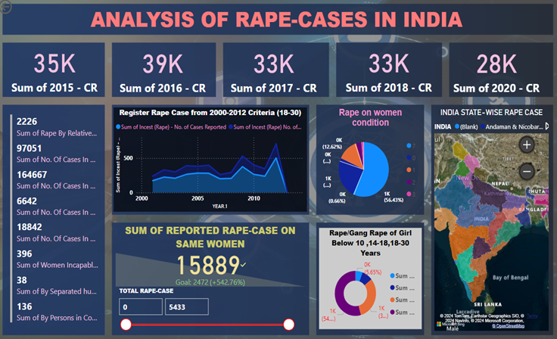
DASHBOARD
Global Crime Trends: An In-Depth Analysis of India's
Crime Growth (1970-2020)
Crime rates have seen a significant and concerning rise across the globe, with India being no exception.
This dataset provides a comprehensive overview of crime growth in India from 1970 to 2020, highlighting the alarming increase in both registered and unregistered cases.
By examining this data, one can better understand the broader implications these trends have had on society, both within India and globally.
This dataset serves as a crucial resource for researchers, policymakers, and analysts seeking to explore the factors driving this increase in crime, its impact on communities.

Slide 33
DASHBOARD
Global Crime Trends: An In-Depth Analysis of India's
Key Information about the dataset
1. Summary of Cases (Rape) 2015-2020:
Description: This file provides a year-wise summary of reported rape cases across various States and Union Territories in India
from 2015 to 2020.
Columns: State/UT, Number of Cases Reported (CR) for each year from 2015 to 2020.
2. Detailed Cases (Registered) Sexual Assault 2001-2008:
Description: This dataset offers detailed information on registered sexual assault cases between 2001 and 2008, including both
incest and non-incest rape cases. It categorizes the number of cases and victims by age group.
Columns: State/UT/City, Year, Number of Cases Reported, Number of Victims categorized by age group, and total figures for
both incest and other rape cases.
3. Cases (Oldest) 1970:
Description: A historical dataset from 1970, providing details on various commodities, including stock levels, across different
districts.
Columns: Date, Code, Commodity ID, Commodity Name, District Name, District Code, Stock, Commodity Stock, Total Stock.

Slide 34

DASHBOARD
Thynk Unlimited
Global Crime Trends: An In-Depth Analysis of India's
Key Information about the dataset
4. Worldwide Cases Details:
Description: This dataset includes global crime data, with information on various indicators across different countries and regions, categorized by sex and age.
Columns: Country (ISO3 code), Region, Subregion, Indicator, Dimension, Category, Sex, Age, Year, Unit of Measurement, Value, Source.
5. Detailed Registered and Unregistered Cases (Sexual Assault) (Punished Release) 2018:
Description: This dataset details both registered and unregistered sexual assault cases from 2018, with a focus on custodial and non-custodial rape cases, including specific punishments.
Columns: State/UT, Year, various custodial and non-custodial rape categories, punishment details, and total cases.
6.State-wise Sexual Assault (Detailed) 1999-2013:
Description: This dataset provides a detailed state-wise account of sexual assault cases from 1999 to 2013, focusing on the relationship between the victim and the offender.
Columns: State/UT, Year, Number of Cases by Offender Relationship (e.g., parents, relatives, neighbors, other known persons).

Slide 35

CONCLUSION
Rape, sexual abuse, and sexual assault affect individuals physically, psychologically, and socially.
Despite legal frameworks and awareness efforts, these crimes continue, highlighting the need for a broader approach.
Prevention, awareness, and education must work in tandem with strong legal and social support systems.
Society must take responsibility for dismantling cultural norms that enable violence and support victims.
A shift is needed in how we perceive gender, power, and respect.
Fostering empathy and educating future generations can lead to a society intolerant of sexual violence.
A multifaceted approach—advocacy, systemic reforms, and continuous education—can bring us closer to eliminating sexual violence.

Slide 36
TE ECS
THANK YOU
FOR YOUR ATTENTION
10th October, 2024

